Slide 1


Slide 2

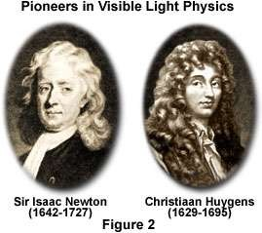

Slide 3

◻ Light consists of very Tiny, Elastic, Rigid particles known as Corpuscular”.
◻ These corpuscles on emission from the source of
light travel in straight line with high velocity
◻ When these particles enter the eyes, they produce image of the object or sensation of vision.
◻ Corpuscles of different colours have different
sizes.
◻ Reflection and refraction of light are because of
repulsive and attractive forces respectively.

Slide 4

◻ Velocity of light in denser medium is greater
than velocity of light in rare medium.
◻ Newton unable to explain simultaneous reflection and refraction
◻ Newton unable to explain polarization and interference concept.
◻ Scientist unable to find out relation between size and colour at larger level. At nano level its true.

Slide 5

◻ Light is propagated in form of waves.
◻ These waves are emitted by the source of light and travel in straight lines with a uniform velocity through a homogeneous medium.
◻ When light enter our eyes it creates an optical impression on the retina. Hence, we get the sensation of light.

Slide 6
◻ Different colours are due to different wavelengths of light
waves.
◻ Light waves are mechanical waves. For propagation of these waves, a hypothetical medium called “luminiferous ether” is present everywhere. Light travels through ether in form of waves.

Slide 7

◻ The phenomena like reflection, refraction, polarization, simultaneous reflection and refraction, total internal reflection, diffraction etc can be successfully explained with this theory.
◻ According to Huygens’ theory the speed of light in denser medium is less than the speed of light in rarer medium. This conclusion is in perfect agreement with the experimental findings.

Slide 8

◻ The existence of so called luminiferous ether,
assumed by Huygens, was not confirmed.
◻ Rectilinear propagation was not explained by the theory. It was then justified by Fresnel.
◻ Diffraction was explained much later.
◻ This theory could not explain photoelectric
emission.

Slide 9
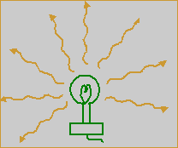
◻ It can be defined as the locus of all the points of the medium to which the wave reaches simultaneously, so that all the points are in the same phase.

Slide 10

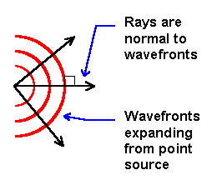
◻ A perpendicular drawn to the surface of the wave front at any point is called a wave normal. This is in the direction of the propagation of light at that point.
◻ The direction in which the light travels is called a ray of light. A wave normal is same as a ray of light.

